Slide 1

Barani Institute of Information Technology
Final Year Project Presentation
Matrimonial Web App
Presented By: Rizwan Zaheer
Supervisor: Munir Ahmad

Slide 2
Introduction
Matrimonial Web Application is to provide Grooms and Brides with matchmaking experience by exploring the true partner.
User can get information regarding their dream life partner.

Slide 3
Objective & Scope
This Application can be use by Every one.
Matrimonial website which will provide platform to a lot of Bride/Groom for finding perfect match.
There are different sectors like Registration, Partner Search, etc. So the Bride/Groom can get their interest for find their partner. Bride/Groom can directly search Partner according to their required criteria.
This application is specially designed for those who have problems in finding partner.

Slide 4


Conceptual Diagram
Request
Request
WEB SERVICE
Response
Response
Request
Mac
User
Response
Mongo DataBase

Slide 5
Tools & Technologies
Visual Studio Code
Html5/ Css3/ Scss
ReactJs/ Redux
NodeJs/ Expressjs
Mongodb (Database)
Adobe Photoshop

Slide 6
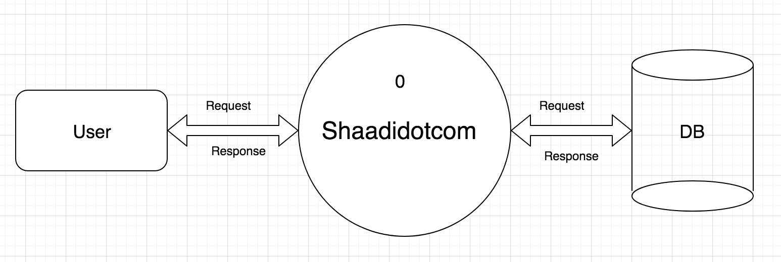
Data Flow Diagram
LEVEL 0

Slide 7
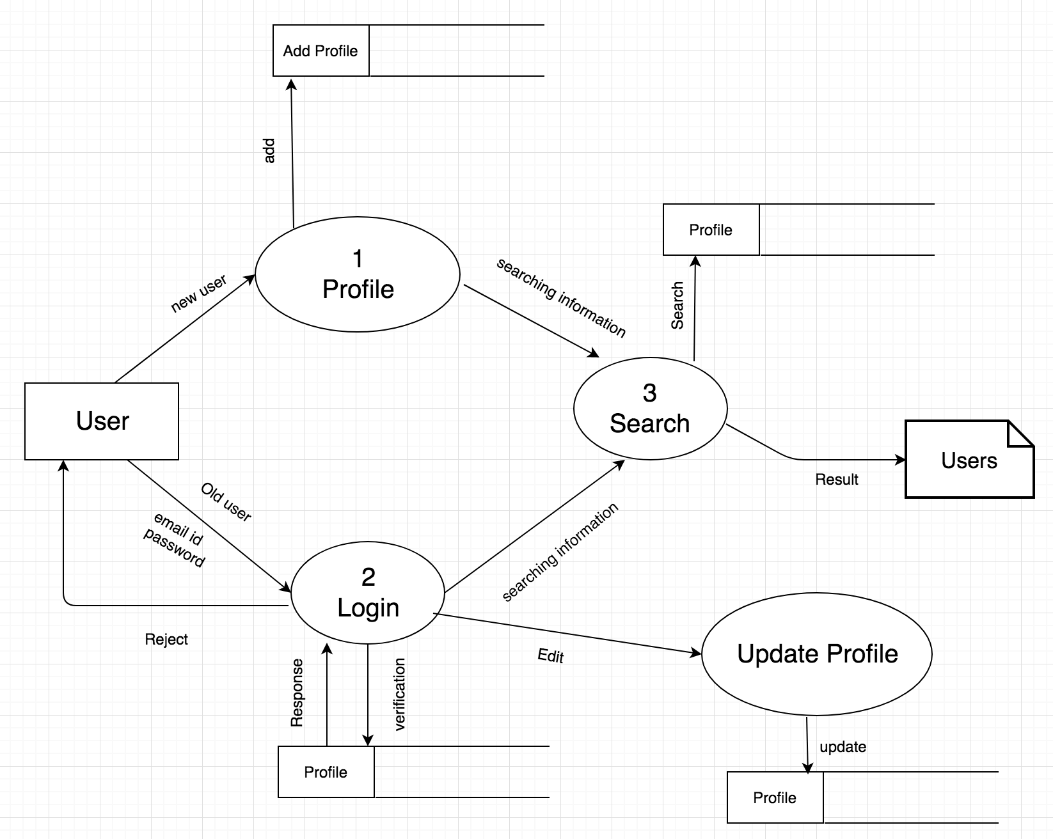
LEVEL 1

Slide 8
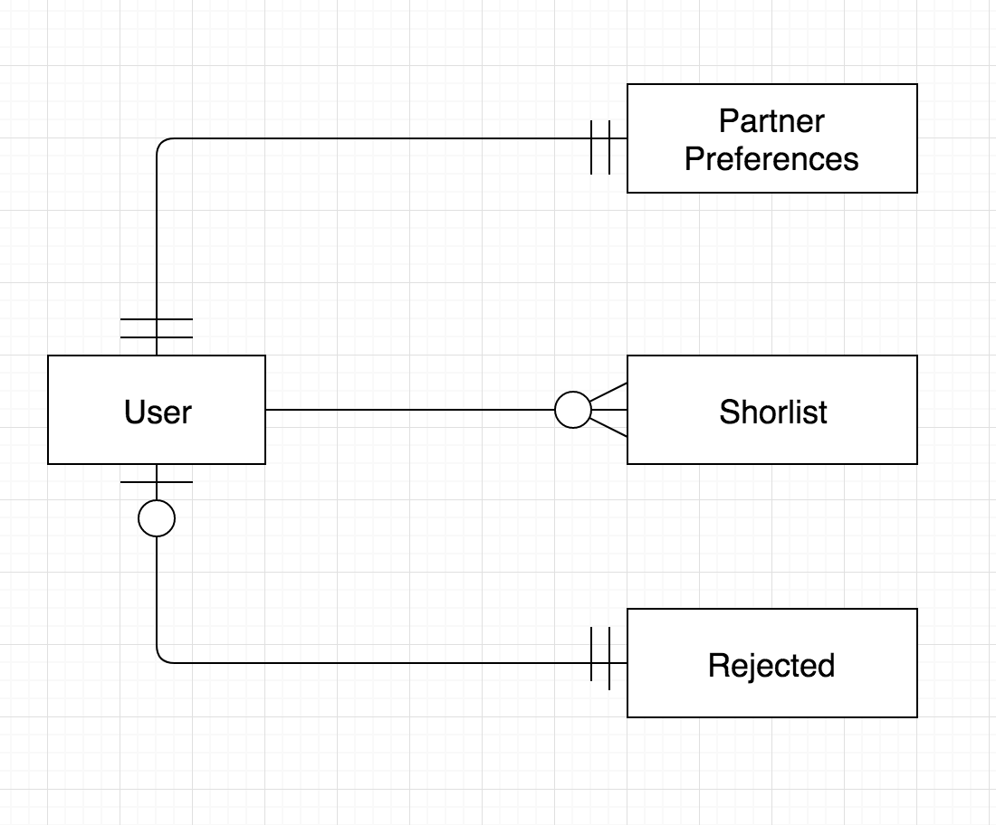
ER-DIAGRAM
M
1

Slide 9
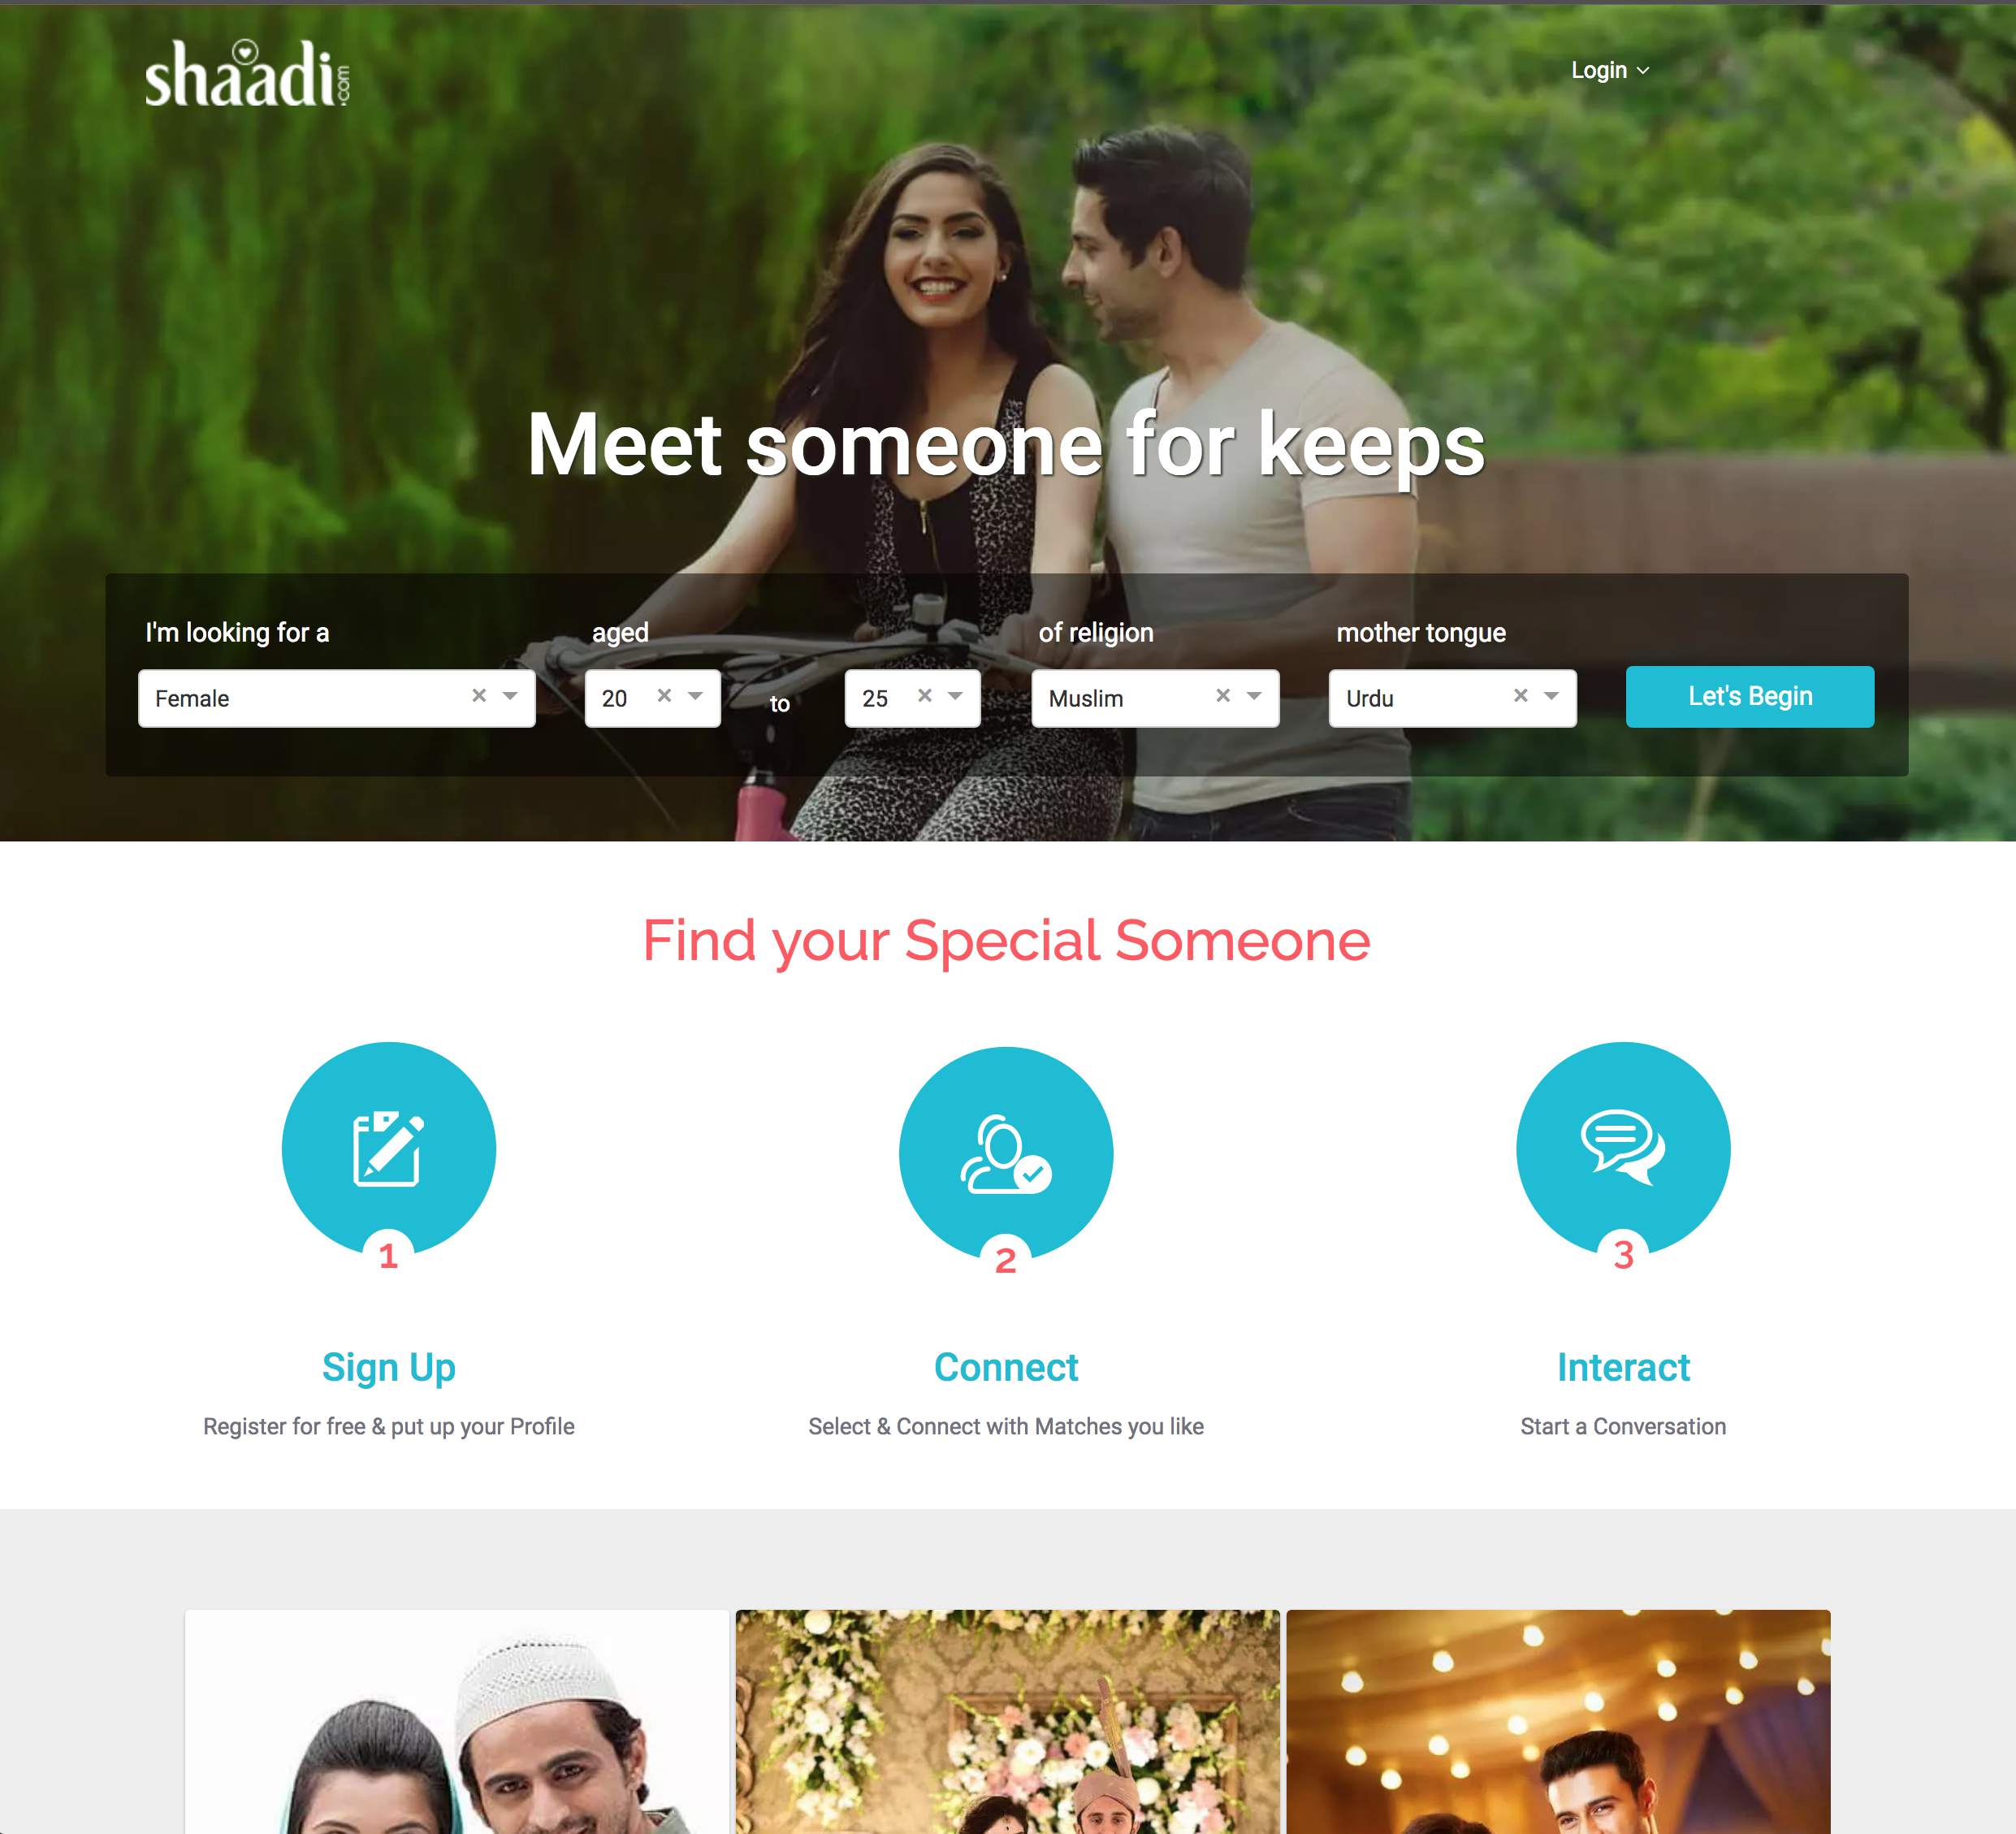
Snapshot

Slide 10
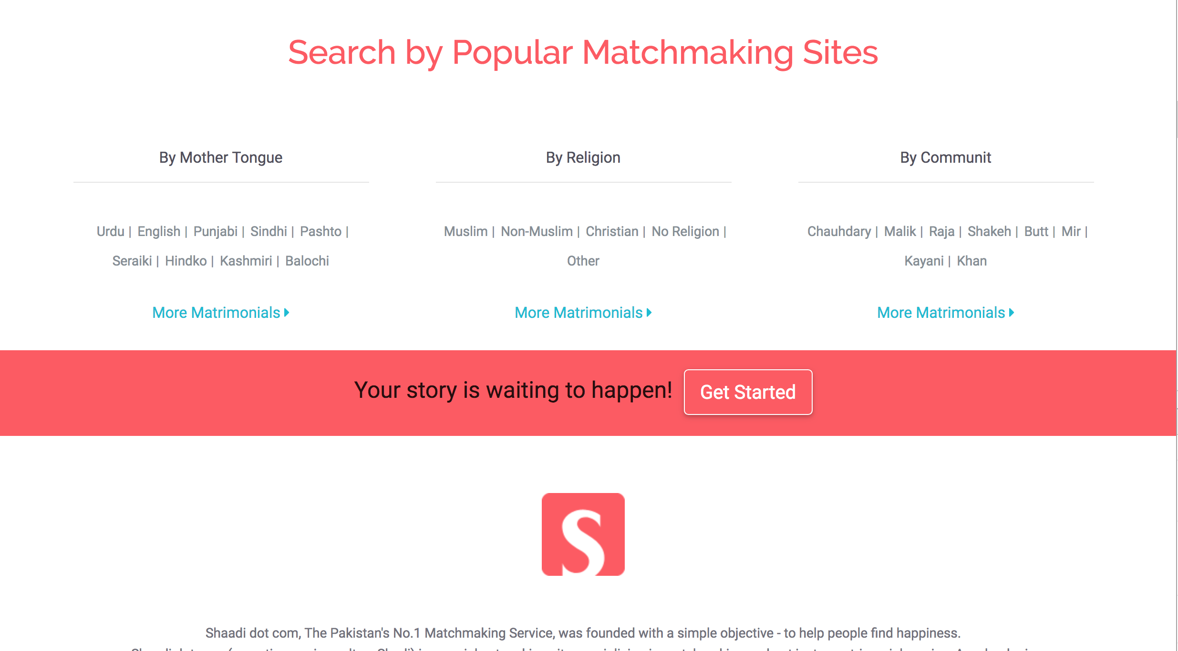

Slide 11
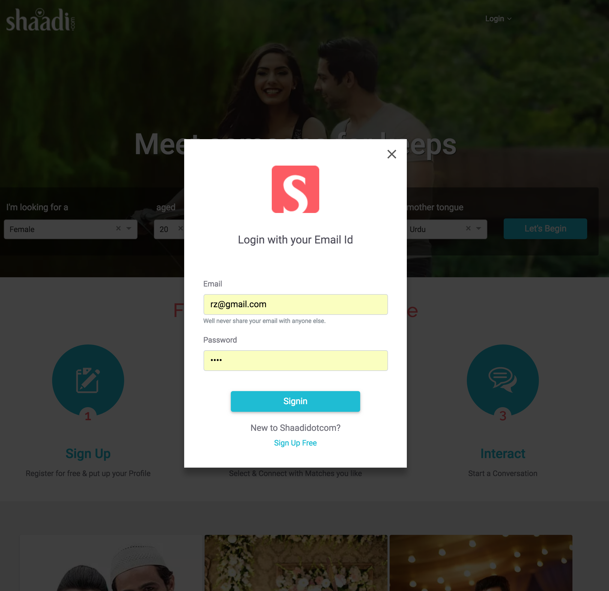
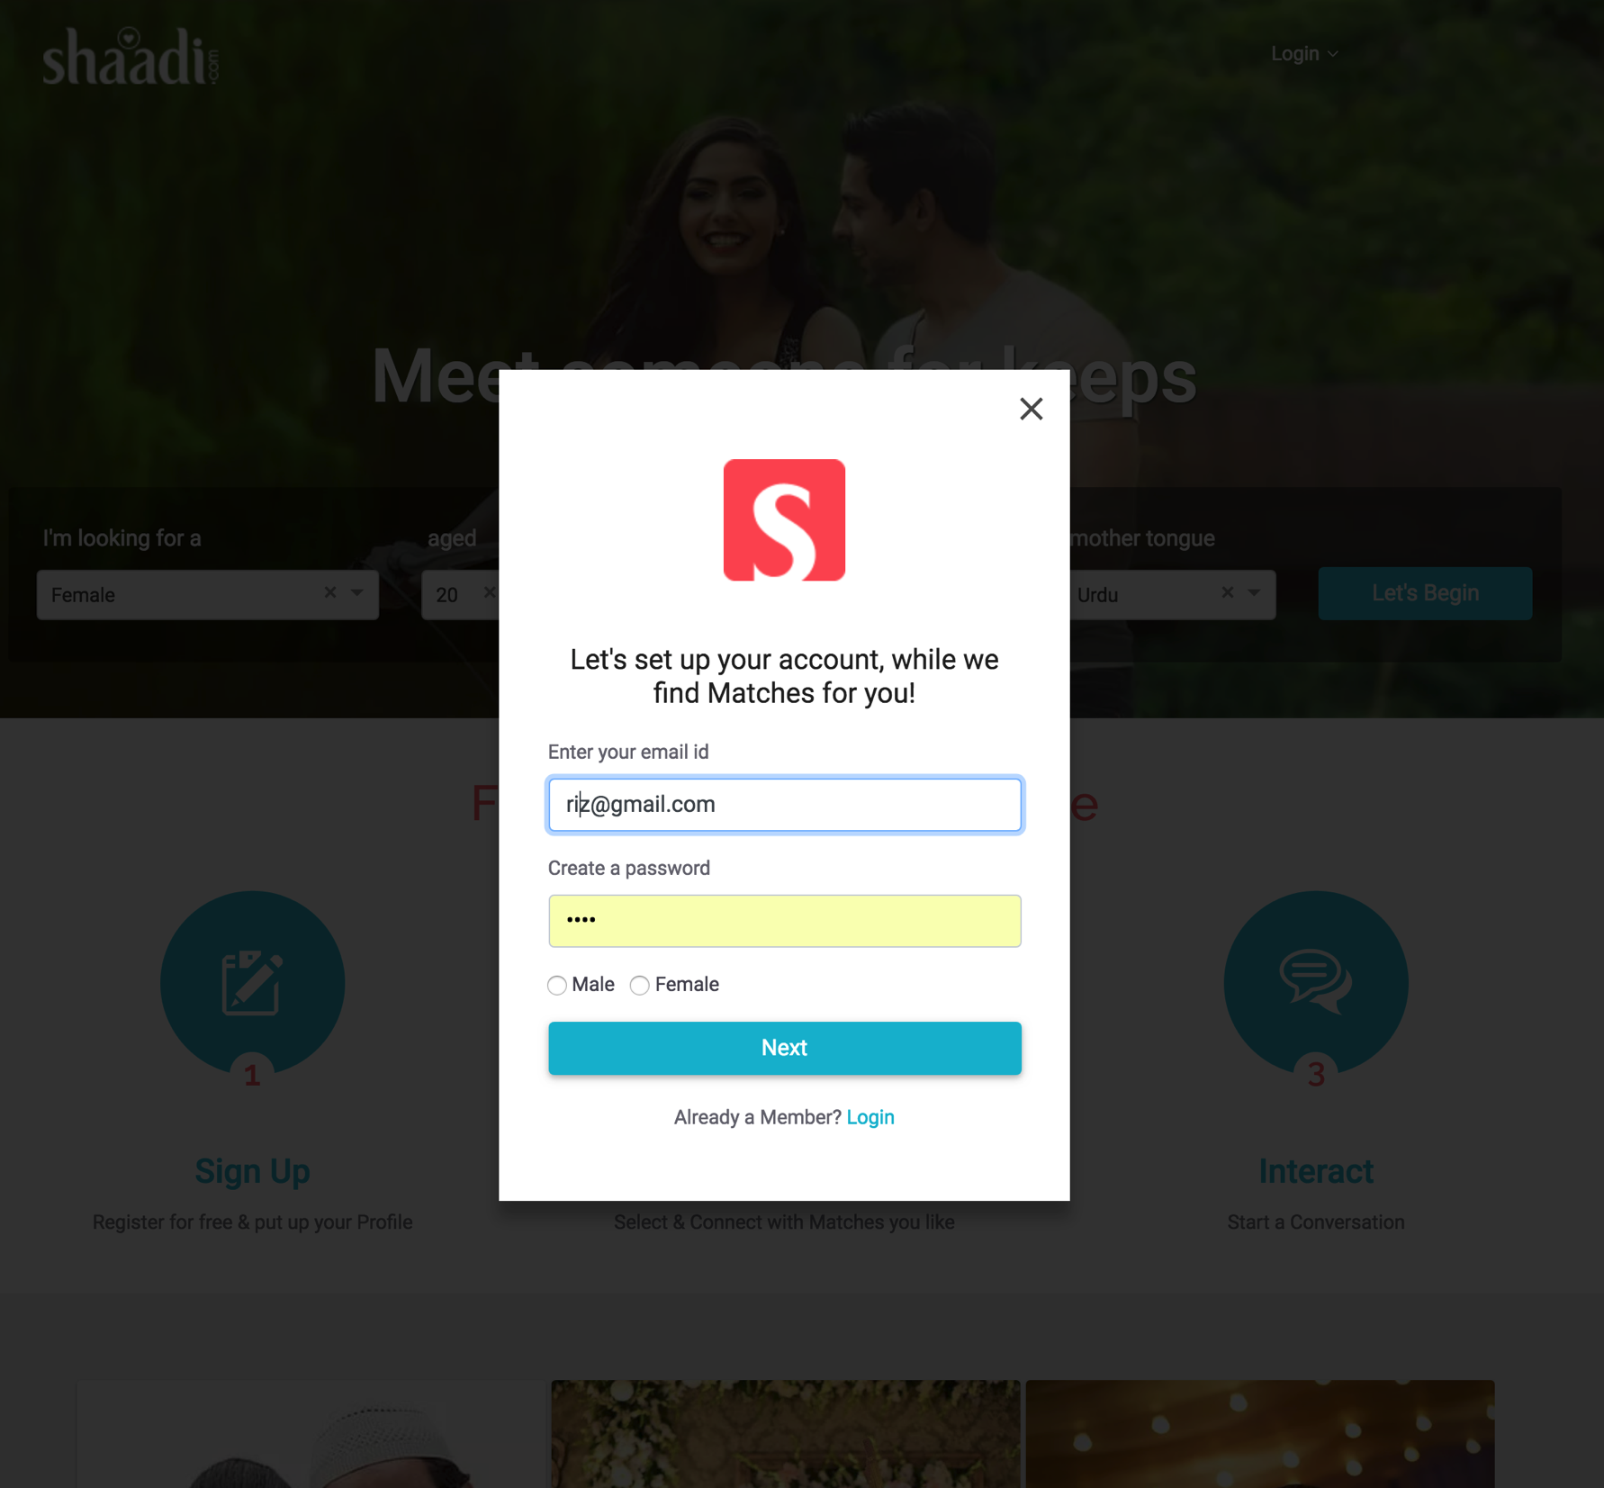
Login Signup

Slide 12
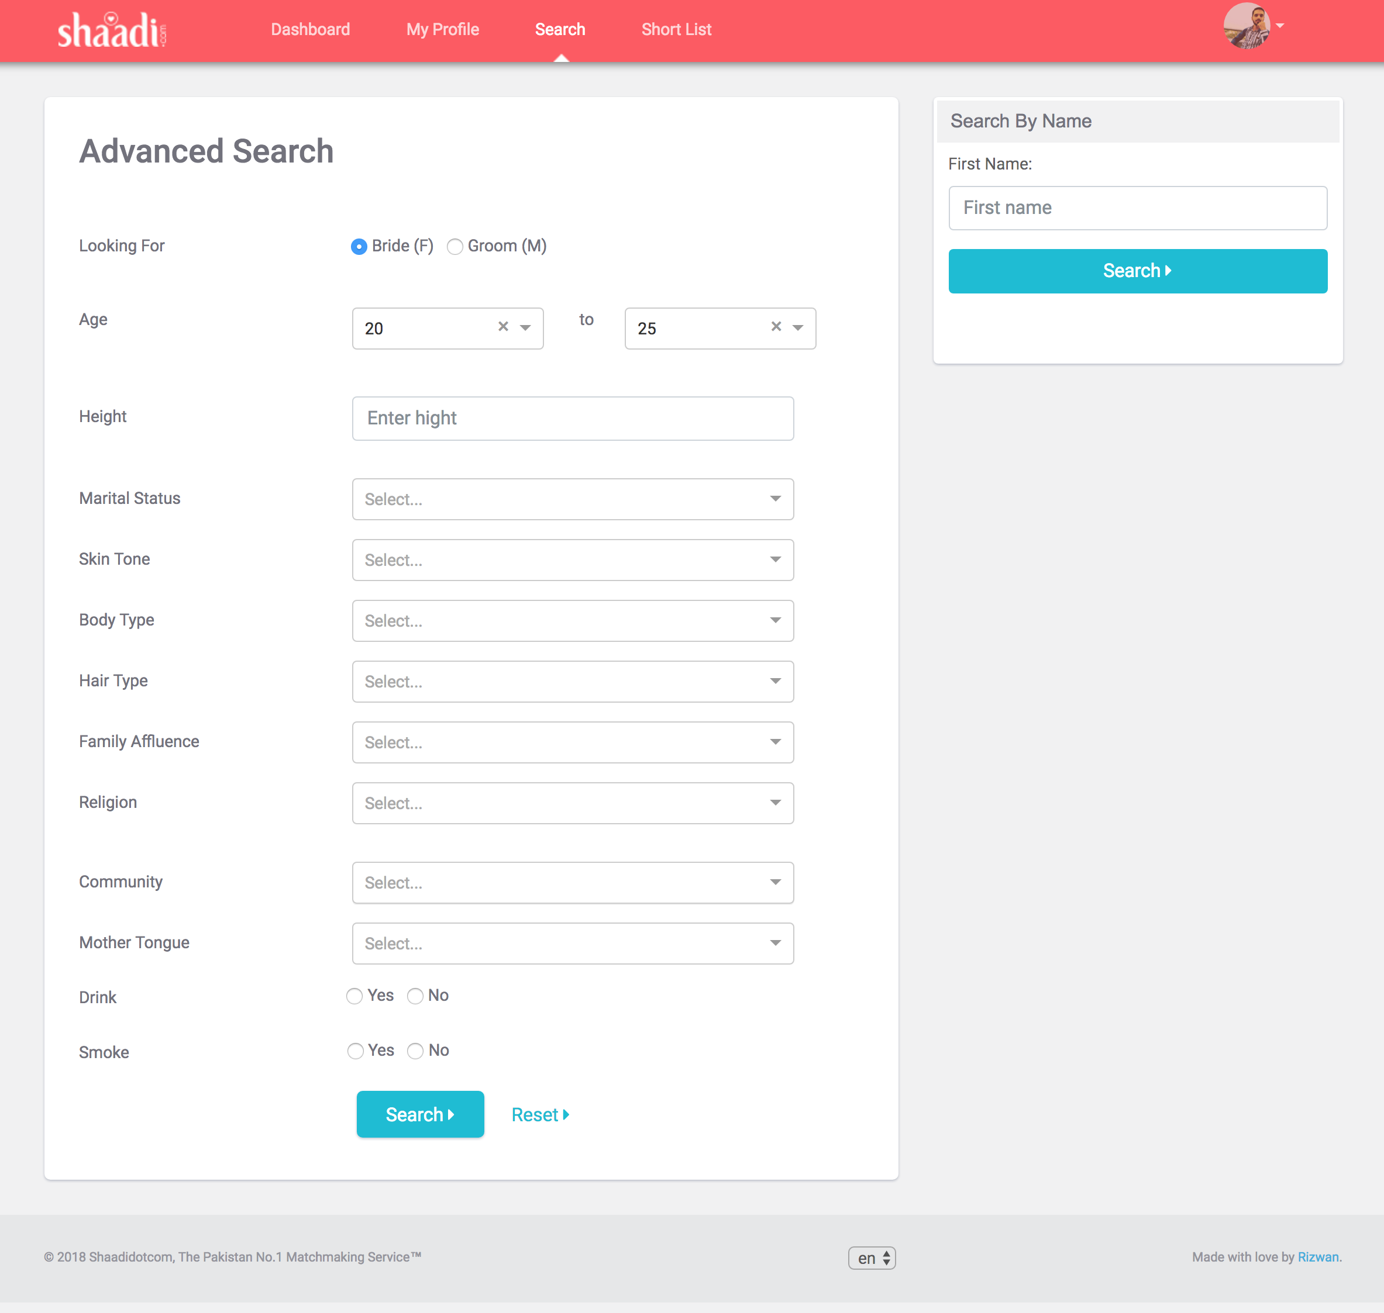
Advance Search

Slide 13
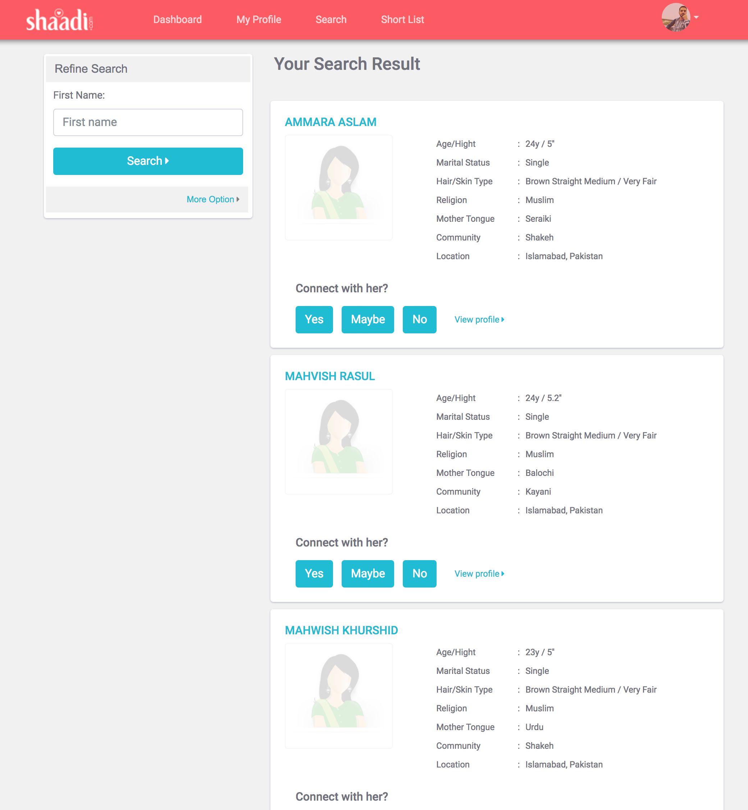
Search Result

Slide 14
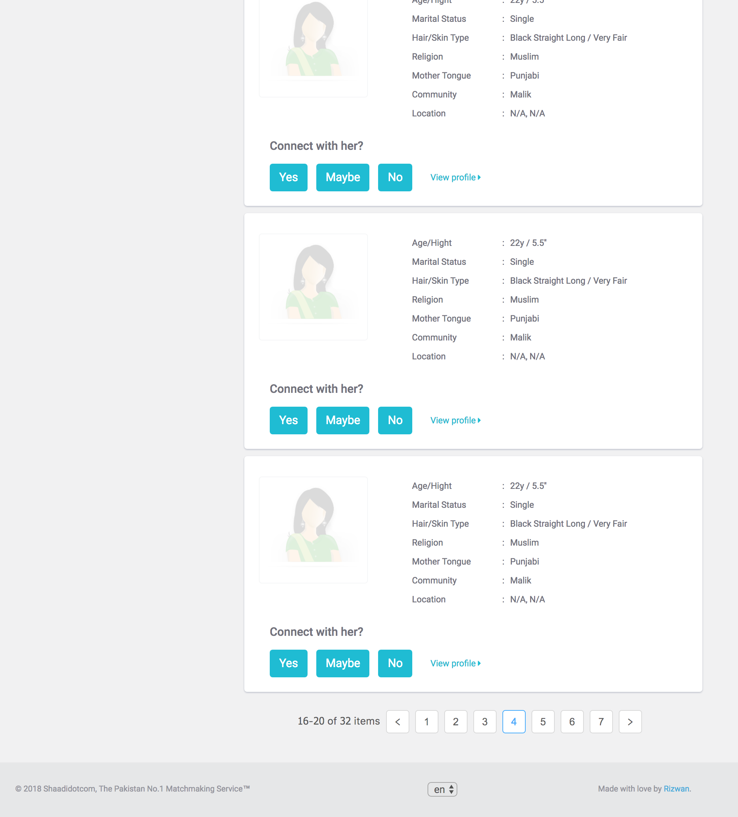
Search Results

Slide 15
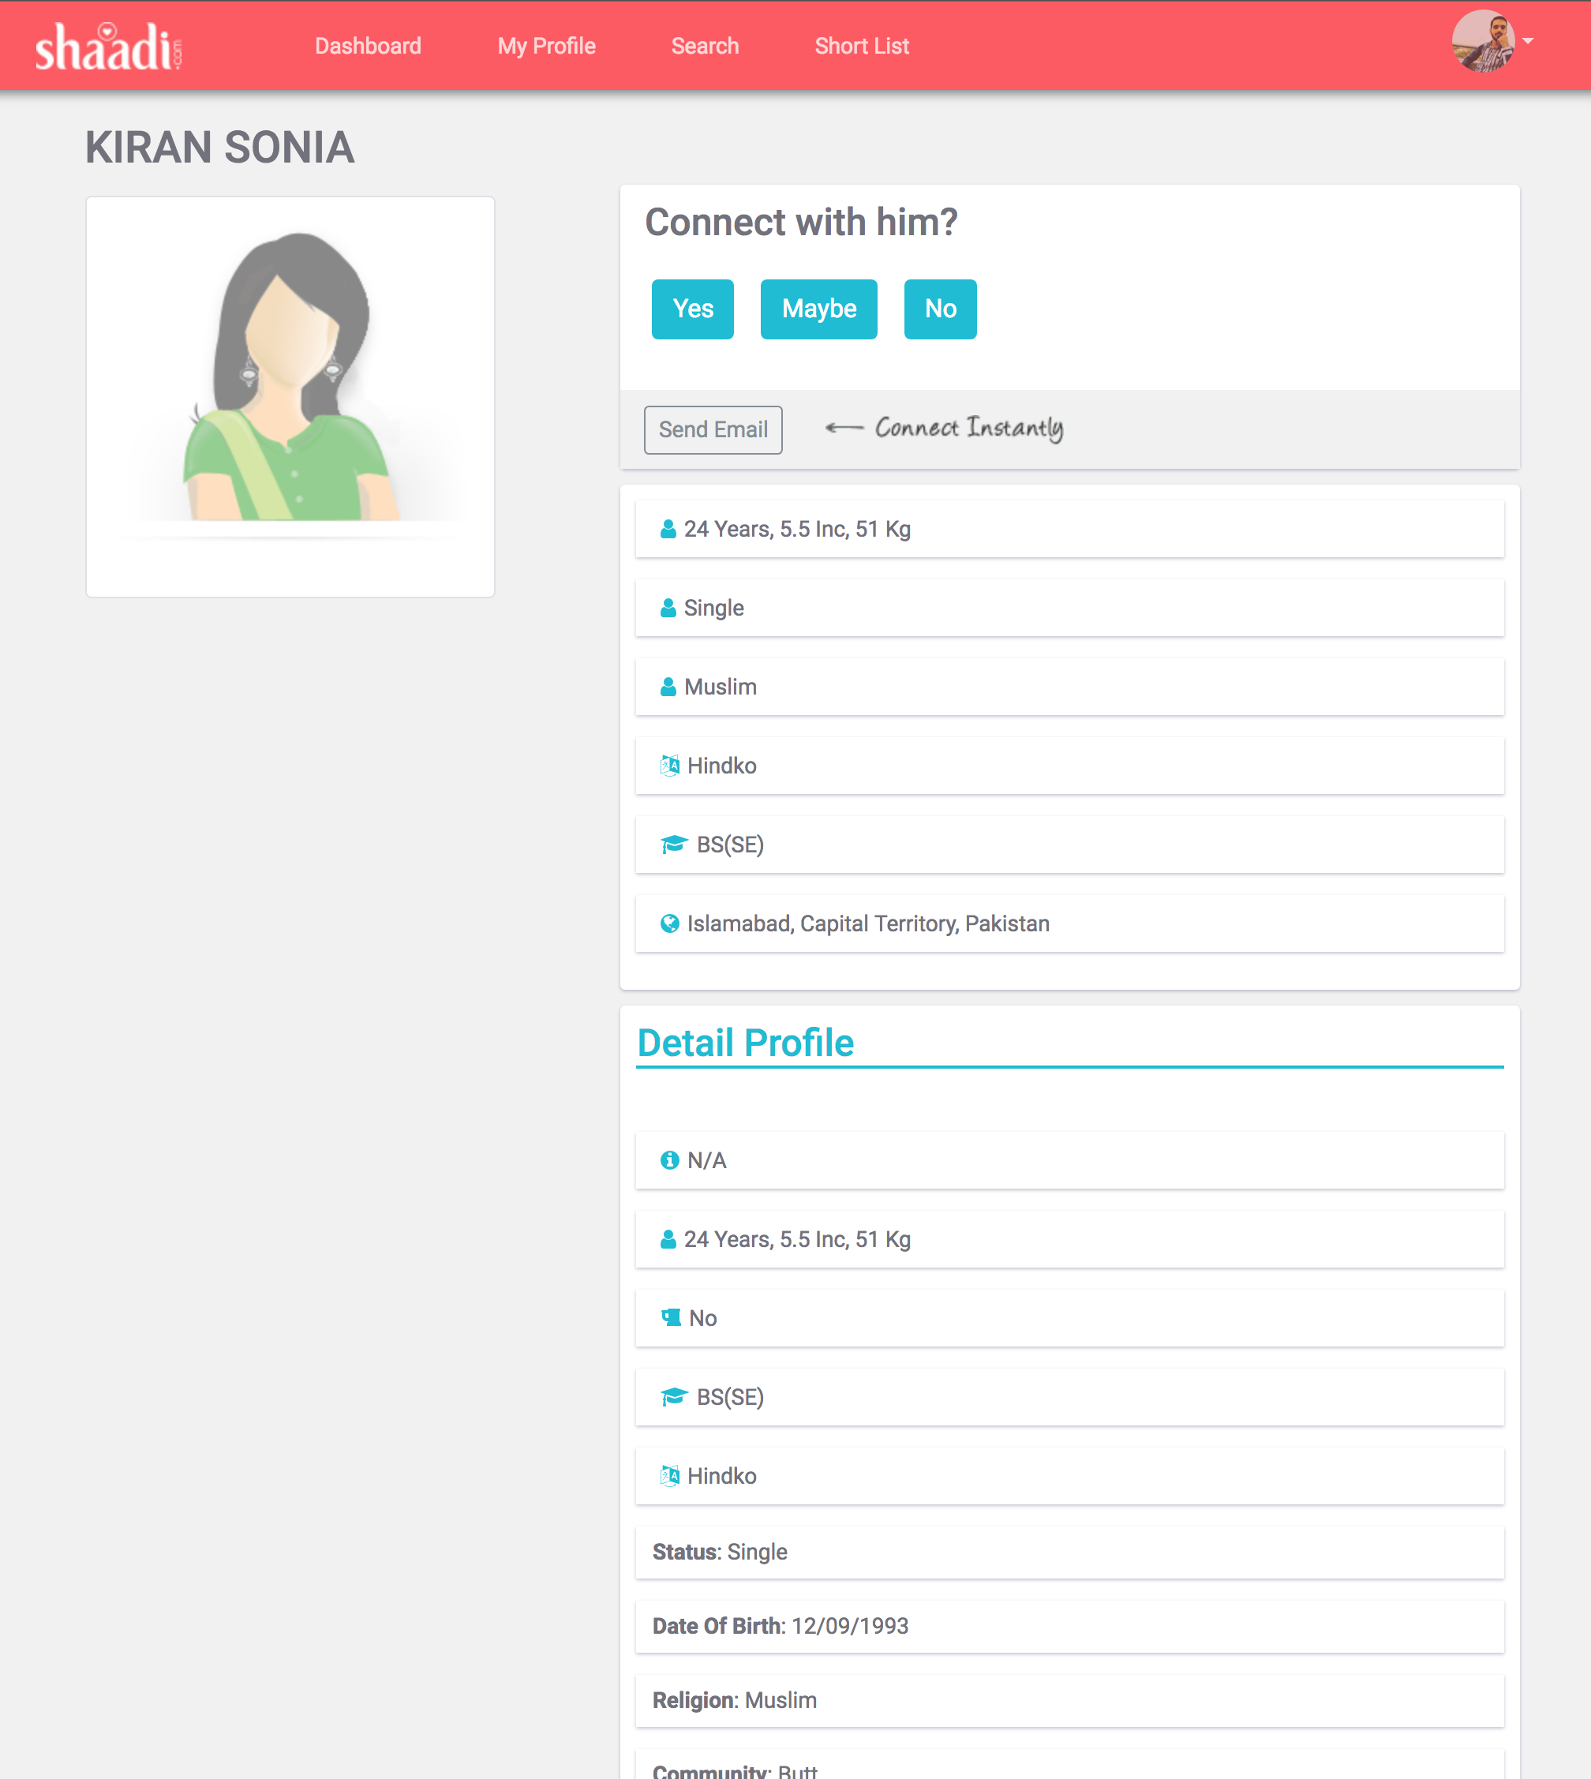
User Profile

Slide 16
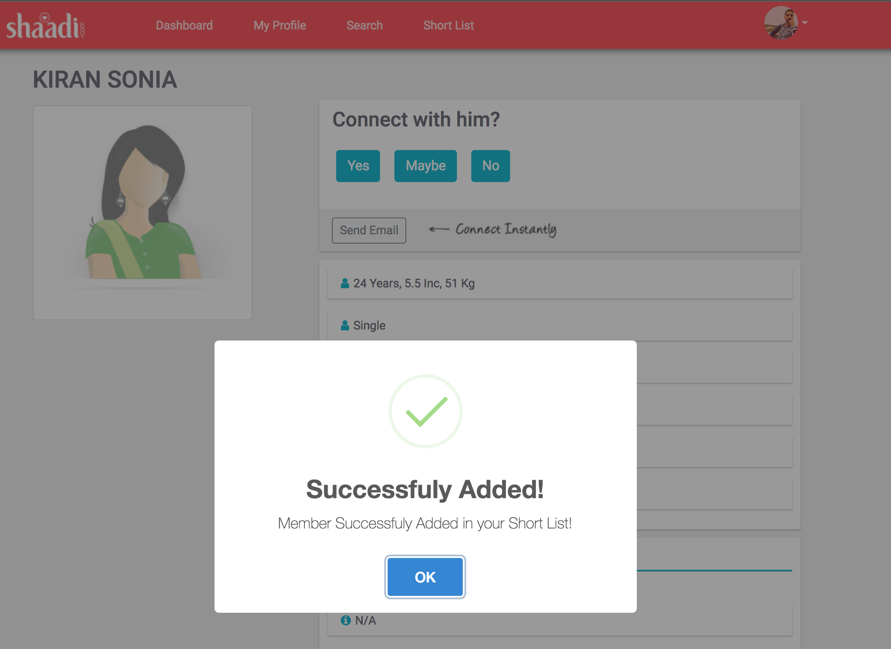
Short List User

Slide 17
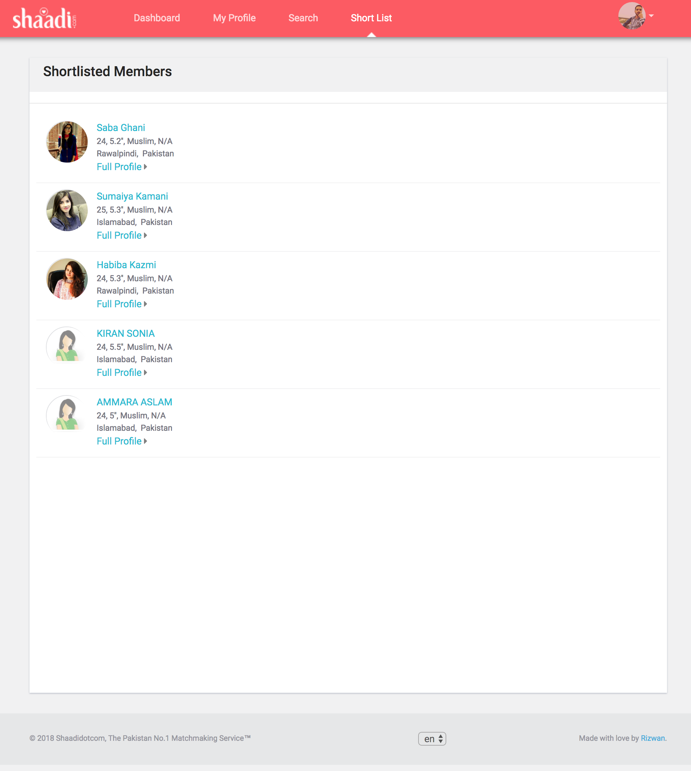
Short Listed Members

Slide 18
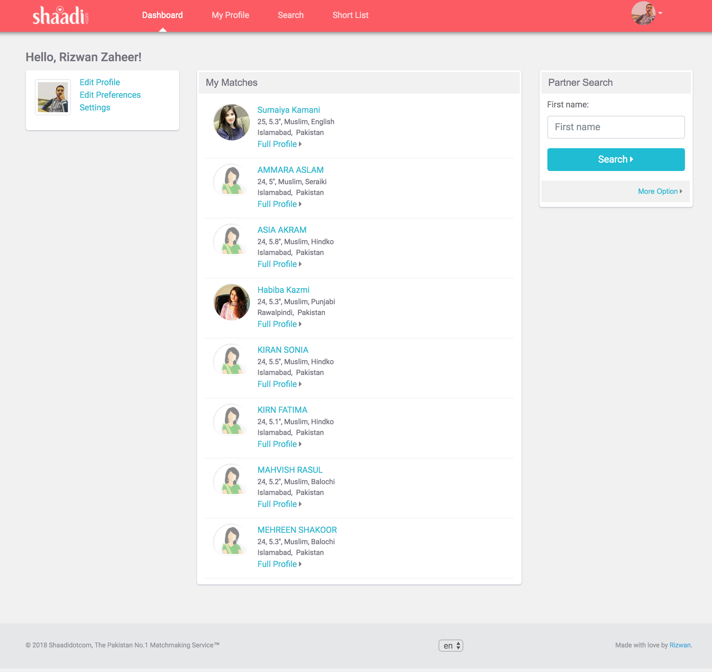
User Dashboard

Slide 19
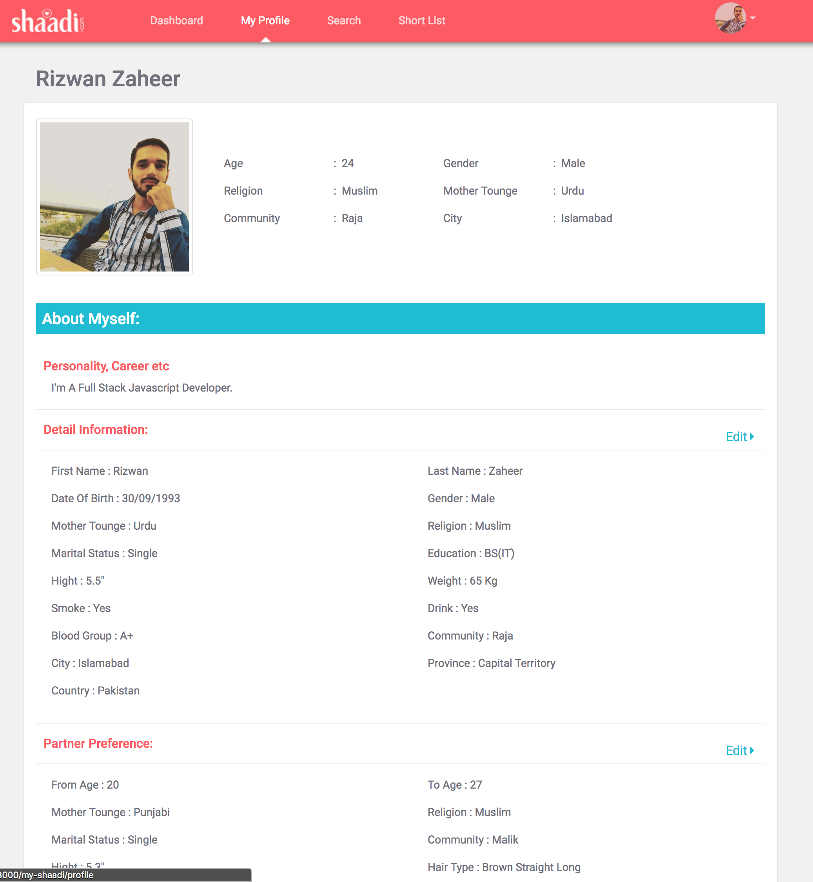
Personal Complete Profile

Slide 20
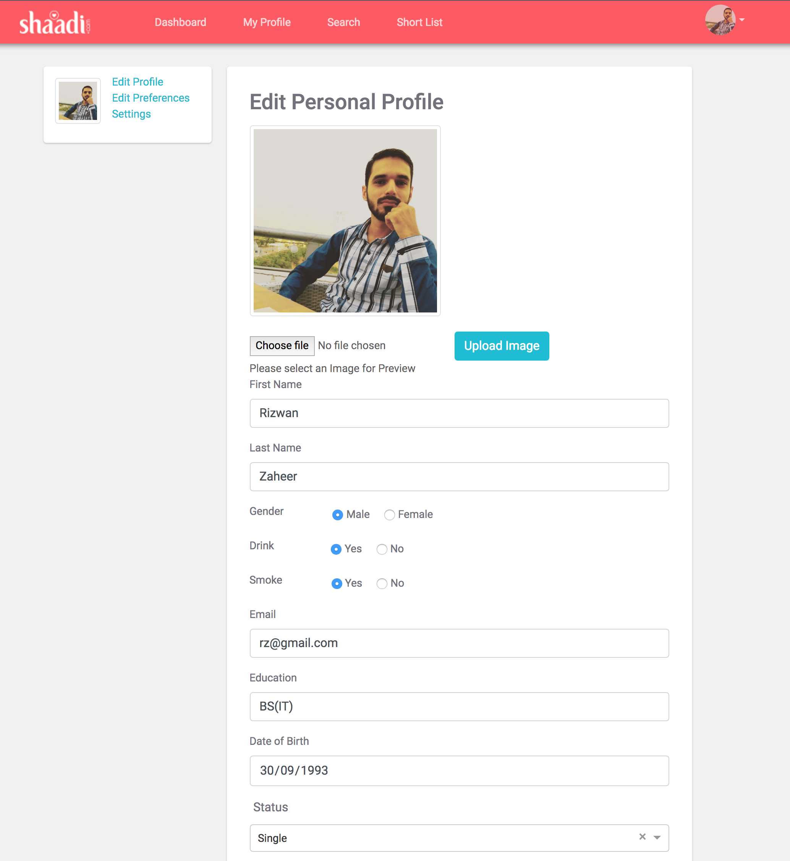
Personal Profile Editable

Slide 21
Thanks You

Slide 22
Problem & Solution:
The problem & solution of the entitled project is for every user to use in their daily life for random to find the perfect life partner.
Matrimonial Web Application will allow a new user to register and after successfully registration user can get email confirmation and his/her profile will be visible to other users.
If any individual who want to use this App simply Enter the name on Google (shaadidotcom), simply open it and Good to go, After the search he can find the perfect match us.

